Slide 1
Governing Azure Resources

Slide 2
In this Video, we are going to take a look at…
What is governance and the trust center
Cost management resource groups and tags
Security with resource groups
Auditing with activity log

Slide 3
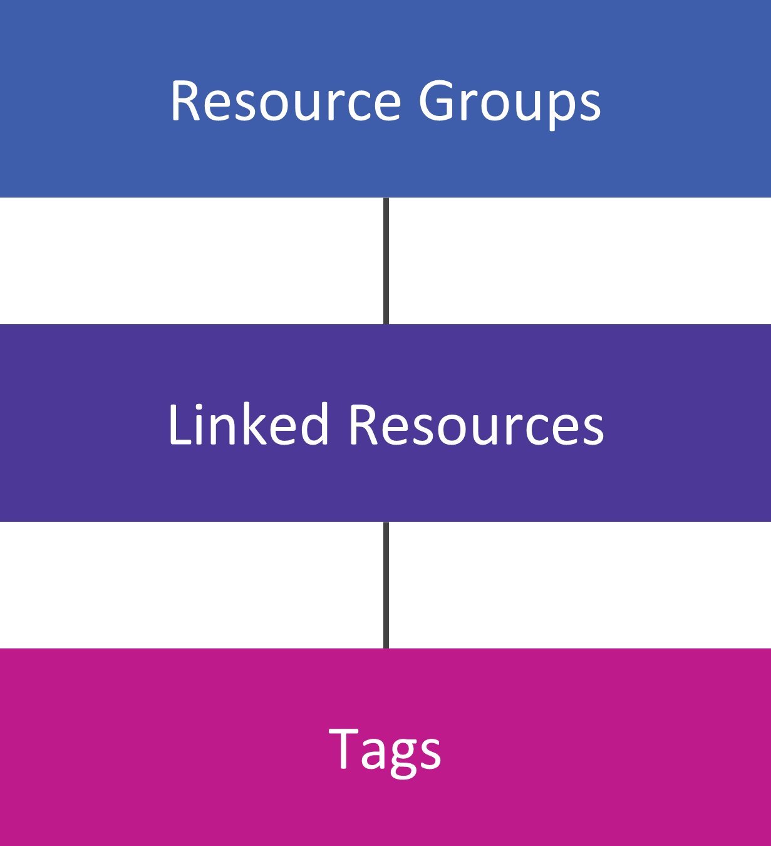
Resource Organization

Slide 4
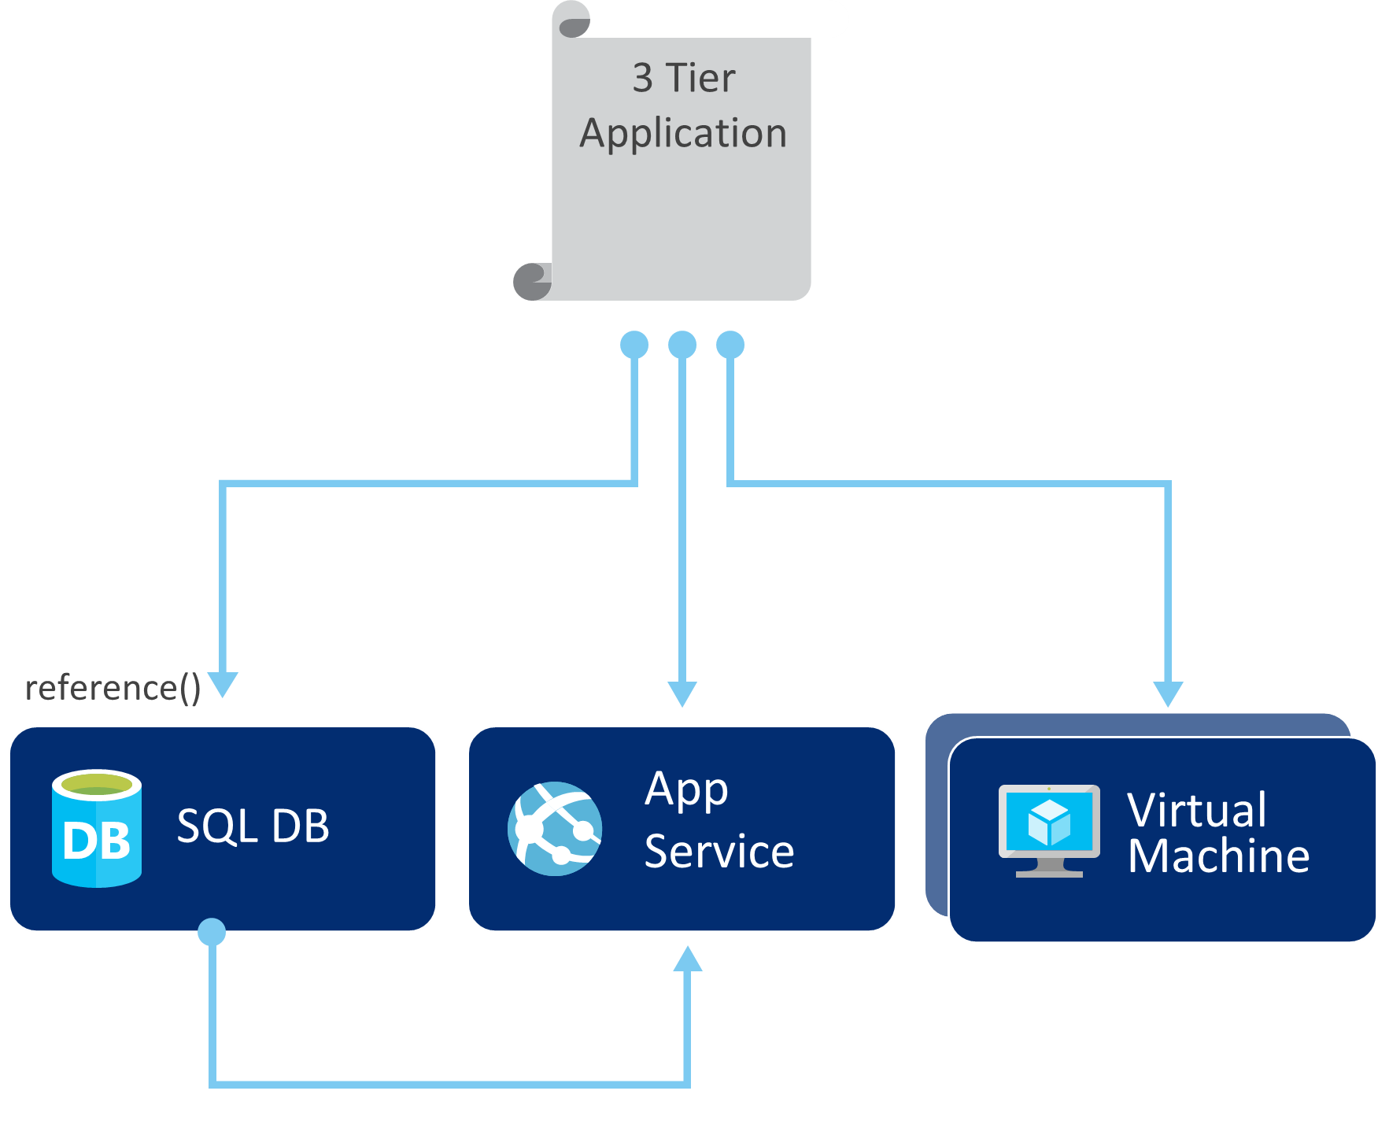
System or App-Centric Resource Groups
Resource Group

Slide 5
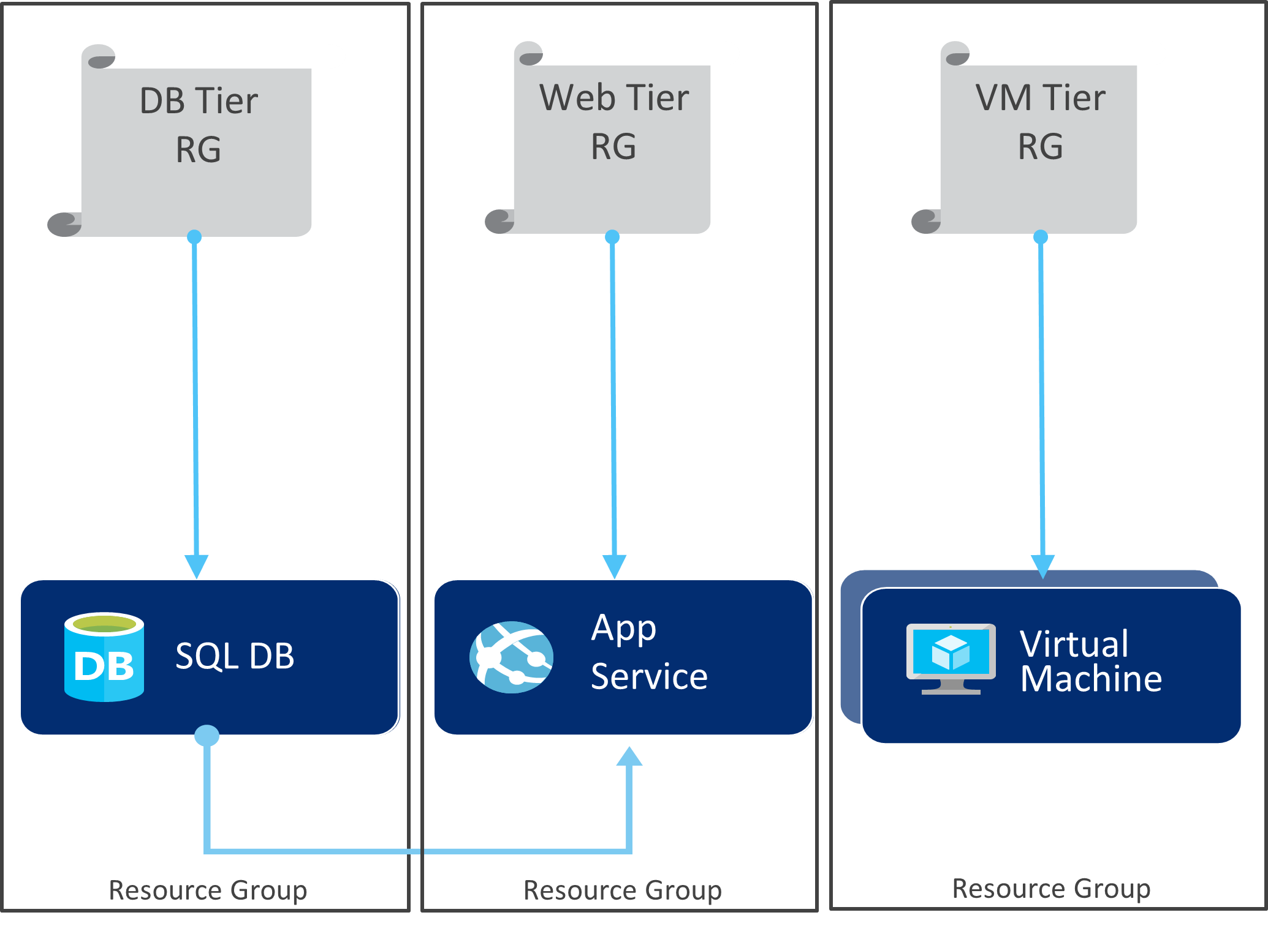
Resource Type or Tier-Centric Resource Groups

Slide 6
Resource Group Organization Misc.
Department or subsidiary centric
Pros and cons of each
Items to consider during decision making
Each customer does it a little different based on their requirements
Cost control step one

Slide 7
Tag Usage for Governance
Tag usage best practices
Cannot be used for security
Used for automation as well

Slide 8
Resource Security and Control

Slide 9
Resource Control within Azure
Role based access control
Resource locks
Resource policies

Slide 10
Role Definitions | Role Assignments
Describes the set of permissions (for example – read actions) | Associate role definitions with an identity (for example –user/group) at a scope (for example – resource group)
Can be used in multiple assignments | Always inherited – subscription assignments apply to all resources

Slide 11
RBAC Inheritance

Slide 12
Key Learnings from Enterprise Customers – Part One
Organizational accounts not live ids –
Use organizational accounts to sign-up and manage Azure
Connect your Azure AD with on-prem AD
Resource Groups not Subscriptions –
Use resource groups to segregate workloads with different access needs
Avoid granting access to individual resources unless necessary
Manage access using groups –
Assign access to AD groups, manage membership of groups for on-going access management.

Slide 13
Key Learnings from Enterprise Customers – Part Two
Enable multi-factor auth –
Use Azure AD conditional access policies to enable MFA for Azure management
Least privilege –
Pick the right role for the job
Contributor not owner
Model on-premises roles using resource-type specific Azure roles
Keep a tab on access changes –
Monitor changes to access settings
Regularly dump and review entire access policy

Slide 14
Key Learnings from Enterprise Customers – Part Two
Accidents happen and resource locks help prevent them
Resource locks allow administrators to create policies which prevent accidental deletion.
Resource lock –
Policy which enforces a "lock level" at a particular scope
Lock level –
Type of enforcement, currently supports CanNotDelete
Scope –
The realm to which the lock level is applied. Expressed as a URI and can be set at the resource group, or resource scope.

Slide 15
Resource Policies
Prevent users from breaking conventions defined to manage Azure resources
Requires authentication into an RBAC role
Unlike RBAC, policy is a default allow and explicit deny system.
Policy definitions at a desired scope –
Subscription
Resource group
Individual resource

Slide 16
Resource Policy Common Scenarios
Forcing all resources to contain defined Tags and Values
Controlling the Region or Location where resources are created
Controlling the specific VM sizes that are allowed for creation
Policy example –
{ "if":
{ "not" :
{ "field" : "tags", "containsKey" : "costCenter" } },
"then" : { "effect" : "deny" }
}

Slide 17
Azure Audit with Activity Log

Slide 18
Scripting Groups and Tags
Next Video

